Slide 1
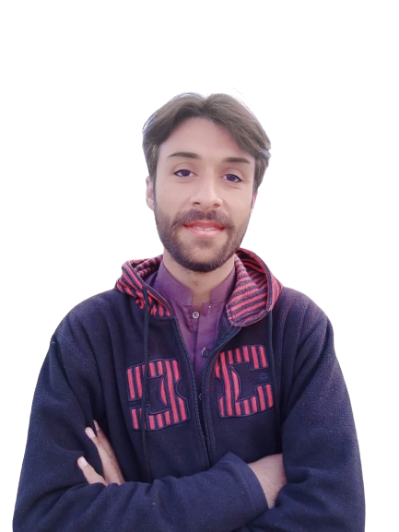
Complex Task Series
Problem Number 23

Slide 2
Problem Statement
Write A Python Program To Generate OTP On User Request

Slide 3
Algorithm
Step1: Ask to user, whether user want to generate a OTP or not
Step2: Get a length of OTP generated sequence of characters
Step3: Then generate a sequence of character containing alphanumeric character as OTP
Step4: Display OTP to user
END

Slide 4
Algorithm
import string
import random
N = 4
res = ''.join(random.choices(string.digits, k=N))
print("The generated random string : " + str(res))

Slide 5
Assignment
Write A Python Program To Generate OTP On User Request And Send Code To Mobile Number

